Slide 1
4 Dimensional Blockchain Scaling with Cosmos and Tendermint
Adrian Brink
London, 2018-04-19
Notes:
Introduction – 1 minutes
I’m Adrian
I work on the Cosmos project
Sorry for the click-bait title but I think it sounds nice and funny

Slide 2
AGENDA
INTRODUCTION TO SCALING / INTEROPERABILITY
SCALING / INTEROPERABILITY
SECURITY MODELS
RECAP
Notes:
Overview – 1 minutes
I’ll explain why this talk is called “4D blockchain scaling”
I’ll try to give an explanation of scalability for every layer of the stack
Security is an orthogonal problem to scalability and I’ll talk about it at the end
Give a concrete example in light of Ethereum
P2P, Consensus, State Machine, Peggy which is similar to Parity Bridge

Slide 3
GOALS
1
UNDERSTAND THE
DIFFERENT SCALING APPROACHES
2
KNOW THE AVAILABLE SECURITY MODELS
3
SCALING IS EVERYONE’S RESPONSIBLITY
Consensus Scaling:
Using Tendermint Consensus
State Machine Scaling:
Cosmos-Sdk || Ethermint
Interchain Scaling:
IBC || Peggy
Social Scaling:
Governance || Developers
Sovereign
Hosted
Plasma
You have to be an Optimistic Planer
Don’t wait for someone else
Actively look for design patterns that allow you to build scalable dApps
Notes:
Goals – 1 minute
Go through them and tell people to remember them as we go through the presentation
These are the most important take-aways from the presentation
If you remember nothing else, just remember this
The general sentiment seems to be that everyone really wants scalability but only very few people are looking for potential solutions or are working on any
Optimistic Planer
Believe that you can have an impact on the future
Have you clear plan on how to get there

Slide 4
INTRODUCTION TO SCALING AND INTEROPERABILITY
SCALING
INTEROPERABILITY
Throughput
Competition for the same compute resources
Many heterogeneous chains
Central synchronization points
Access to liquidity
Notes:
Introduction – 5 minutes
Scaling
Throughput of Ethereum limited to 12-15 transactions per second
Throughput of Bitcoin limited to 5-7 transactions per second
Everyone is competing for the same compute resources
CryptoKitties vs CryptoZombies vs Payments
Currently we are massively constrained by the amount of throughput
Interoperability
Many chains which are not able to talk to each other
Forces centralisation points
Limits liquidity for application developers

Slide 5
SCALING
CONSENSUS SCALING
STATE MACHINE SCALING
INTERCHAIN SCALING
SOCIAL SCALING
Notes:
Overview – 1 minutes
I’ll explain why this talk is called “3D blockchain scaling”
I’ll try to give an explanation of scalability for every layer of the stack
Security is an orthogonal problem to scalability and I’ll talk about it at the end
Give a concrete example in light of Ethereum
P2P, Consensus, State Machine, Peggy which is similar to Parity Bridge

Slide 6

CONSENSUS SCALING
Nakamoto Consensus
Validation
Propagation + Mining
Validation
Propagation + Mining
BFT Consensus
Validation
Propagation
Validation
Propagation
Notes:
Consensus Scaling – 5 minutes
Nakamoto Consensus
Chain based consensus - longest chain wins
Need for safety margin in order to account for network latency so that block time doesn’t drop below network latency
Probabilistic finality
BFT Consensus
BFT has safety in asynchrony and automatically extends block times to allow for liveness

Slide 7
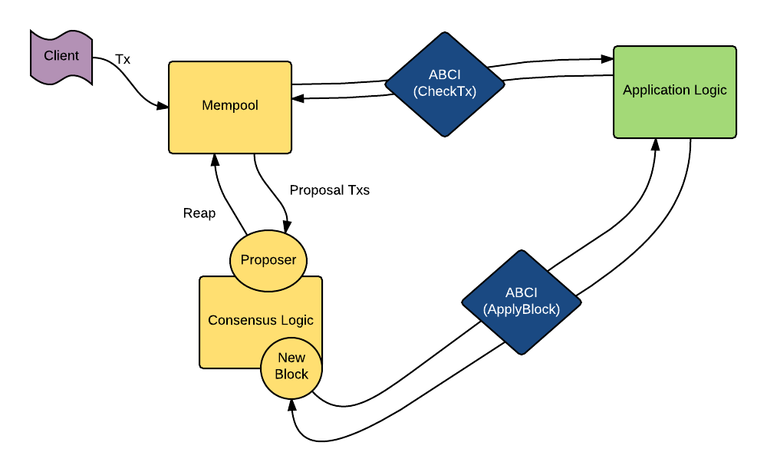
CONSENSUS SCALING
Notes:
Consensus Scaling – 5 minutes
Tendermint Consensus
Advantages
Instant finality
Efficient light client proofs – only need headers if the validator set changes > 1/3
4,000 tps on 64 validators around the world in AWS datacenters
Extremely old benchmark from 3 years ago
Disadvantages
High network overhead
Future Improvements
BLS signatures to aggregrate votes on the P2P layer
Optimistic pipelining
Using prevote from previous block as precommit for next block
DKG extension ala Honeybadger
Prevents validators front-running
Practical Takeaways:
Usable today with an implementation as Tendermint Core
Parity client also includes an implementation
I haven’t looked into it too much, you should speak to Robert if you are interested in it

Slide 8
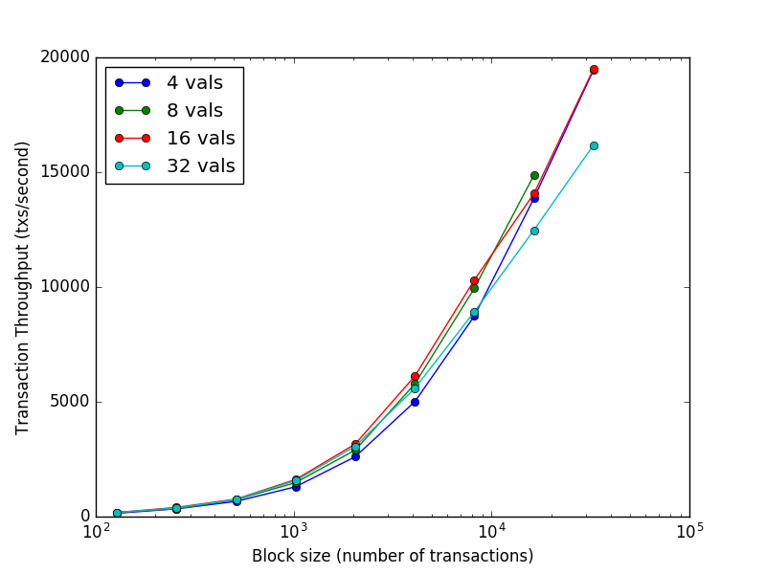
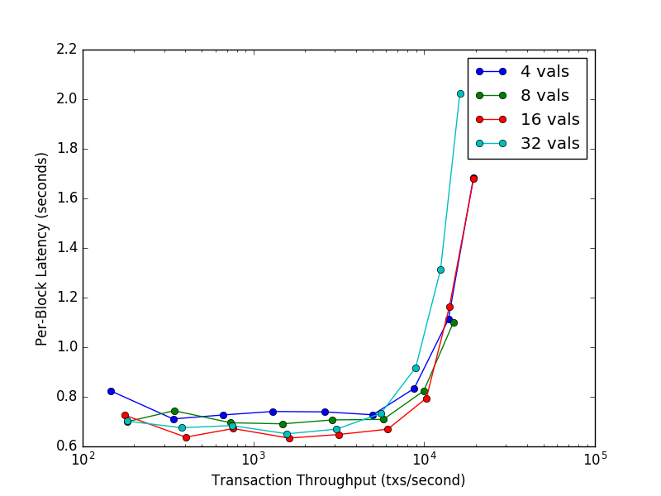
CONSENSUS SCALING
Notes:
Consensus Scaling – 5 minutes
Tendermint Consensus
Advantages
Instant finality
Efficient light client proofs – only need headers if the validator set changes > 1/3
4,000 tps on 64 validators around the world in AWS datacenters
Extremely old benchmark from 3 years ago
Disadvantages
High network overhead
Future Improvements
BLS signatures to aggregrate votes on the P2P layer
Optimistic pipelining
Using prevote from previous block as precommit for next block
DKG extension ala Honeybadger
Prevents validators front-running
Practical Takeaways:
Usable today with an implementation as Tendermint Core
Parity client also includes an implementation
I haven’t looked into it too much, you should speak to Robert if you are interested in it

Slide 9
CONSENSUS SCALING
Current
Instant Finality
Efficient light-client proofs
Safety in asynchronous networks
Liveness in partially synchronous networks
4,000 tps on 64 validators
High network overhead - O(N^2)
Future Improvements
BLS signatures
Optimistic pipelining
DKG construction
Liveness through synchrony assumption
Notes:
Consensus Scaling – 5 minutes
Tendermint Consensus
Advantages
Instant finality
Efficient light client proofs – only need headers if the validator set changes > 1/3
4,000 tps on 64 validators around the world in AWS datacenters
Extremely old benchmark from 3 years ago
Disadvantages
High network overhead
Future Improvements
BLS signatures to aggregrate votes on the P2P layer
Optimistic pipelining
Using prevote from previous block as precommit for next block
DKG extension ala Honeybadger
Prevents validators front-running
Practical Takeaways:
Usable today with an implementation as Tendermint Core
Parity client also includes an implementation
I haven’t looked into it too much, you should speak to Robert if you are interested in it

Slide 10
STATE MACHINE SCALING
ETHERMINT
COSMOS-SDK
Notes:
State Machine Scaling – 5 minutes
General idea is that we make the state machine much faster
Parity is 2.5x faster than Geth
Currently everyone builds on top of the EVM
Most applications don’t need to be build on top of the EVM
Only useful if you need user level turing completeness
If you users aren’t going to deploy their own smart contracts to interact with your dApp I have doubts whether the EVM is the right deployment environment
Not secure
Not scalable
Not easily customizable
Ethermint is a state machine that takes advantage of the underlying consensus improvements
An EVM that is build as a blockchain application on top of Tendermint Core
Full support for Web3
Provides extremely efficient light-clients
Runs 15x as fast
1 block a second which gives me 15x throughput
Could potentially increase the block gas limit to get another 4x
Cosmos-Sdk as a framework for building your own blockchain application
Everything is a module and modules can be combined
It used to be very hard to build your own blockchain application, most people just forked bitcoin
Allows developers to build their own version of Bitcoin in probably around 200 lines of code
Future improvements:
Enabling different VMs as modules
Multi-language support
Not the the answer to all vertical scaling needs, but it’s fully compatible with other solutions such as:
State Channels
Zk-Snarks

Slide 11
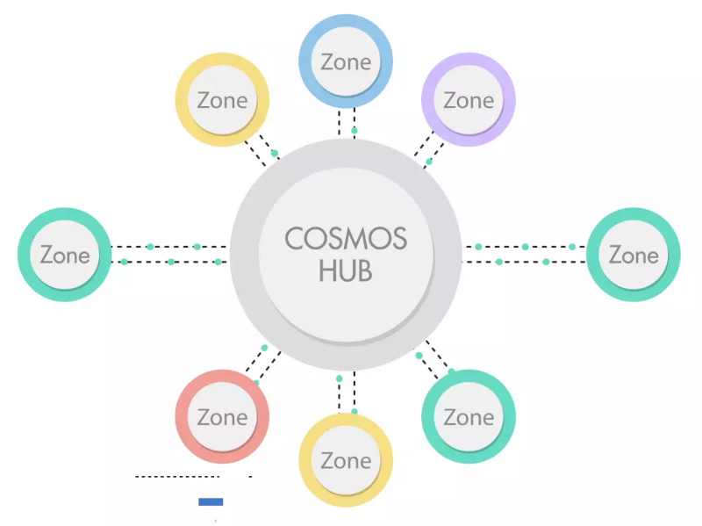
INTERCHAIN SCALING
IBC
Secure transfers between heterogeneous blockchains
Tokens -> NFTs -> Complex Objects
IBC + Adaptors
Adapter to enforce finality
Allows IBC connections to non-finality chains
Cosmos Hub
Liquidity provider for all connected blockchains
Maintains double-spend protection between blockchains
Notes:
Interchain Scaling – 5 minutes
There are limits to vertical scalability
Interchain scaling enables horizontal scaling and allows for heterogeneous chains to connect
IBC
Locks tokens to the consensus of the other chain
Allows for secure transfers between implementing chains
Starts with tokens, then NFTs, then complex objects
Peggy
A way to connect non-finality chains
Enforce pseudo-finality
Bad things happen when a reorg happens after the finality threshold
Cosmos Hub
In a world of multiple chains, we need a liquidity aggregator that other chains can use
Maintains the double spend protection of a normal blockchain but between multiple blockchains

Slide 12
SOCIAL SCALING
Development
Increasing adoption
Security of your codebase
Working with a large group of people
Governance
Evolving the protocol
Ability to govern the network
Notes:
Social Scaling – 5 minutes
Development
Scaling the development process and the amount of people that understand and verify the protocol
Being able to harness the power of many different people in developing protocols
Governance
Being able to effectively evolve the protocol
The ability to decide on changes (even to state) based on social consensus

Slide 13
SECURITY MODELS
SOVEREIGN
HOSTED
PLASMA
Notes:
Modes of Security – 5 minutes
Sovereign
Own validator set
Full control over the application
Needs to figure out their own security model in terms of PoS
Hosted
Akin to Polkadot
Guest is validated by the same validator set as some other chain
Staking and slashing happens on the host
Control is given to the host validators
Host validators might require a higher fee in order to run the guest zone
Plasma
V1 only requires working consensus on child chain
Validators can always unbound
V2 once fraud proofs for arbitrary applications are solved
Allows anyone to hard exit
Limited by throughput of the root chain

Slide 14
RECAP
1
UNDERSTAND THE
DIFFERENT SCALING APPROACHES
2
KNOW THE AVAILABLE MODES OF SECURITY
3
SCALING IS EVERYONE’S RESPONSIBLITY
Consensus Scaling:
Using Tendermint Consensus
State Machine Scaling:
Cosmos-Sdk || Ethermint
Interchain Scaling:
IBC || Peggy
Social Scaling:
Governance || Developers
Sovereign
Hosted
Plasma
You have to be an Optimistic Planer
Don’t wait for someone else
Actively look for design patterns that allow you to build scalable dApps
Notes:
Goals – 1 minute
I hope that you took something away from this and that you enjoyed it – If you have any feedback, I’d welcome it later over Twitter DMs
Go through them and tell people to remember them as we go through the presentation
These are the most important take-aways from the presentation
If you remember nothing else, just remember this
The general sentiment seems to be that everyone really wants scalability but only very few people are looking for potential solutions or are working on any

Slide 15
CALL TO ACTION
Scaling is Everyone’s Responsibility! Don’t just wait for someone else to solve it for you!
Notes:
Call to Action - 1 minute
Big shout out to FunFair – they actually implemented their own scaling solution

Slide 16
Any Questions?
Adrian Brink
@adrian_brink
cosmos.network
Notes:
Questions – 5 minutes

